Slide 1
MJ² Robotics
Maryam Abdul-wahid, John Gentry, and Jacob Dorer

Slide 2
Designing a better future for robokind.

Slide 3
Robotic Achievements
Design features that make our robot raise above the rest.

Slide 4
Step C Requirements
Line following
Follows a black line on the floor
Robot makes corrections depending on the lines location
Turns around and returns to starting point

Slide 5
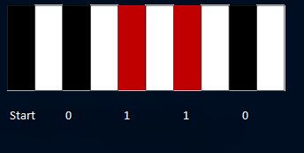
Step B Requirements
Reads in Binary information
Binary information will be represented as seen below
The first black strip is the
start bit
The following bits are red for 1 or black for 0
The information will then be displayed on an LCD

Slide 6
Step A Requirements
Map a separate PWM pin and Timer to use for music
Program simple music using PWM
Map a PWM pin to an op amp
Add an 8 ohm speaker to the op amp

Slide 7
Proposed Design
Hardware
software
Basic Robot Build
IR transmitters and receivers
Speaker
Wired controller
Line following algorithm
Bar code reader
Programmed Music using PWM

Slide 8
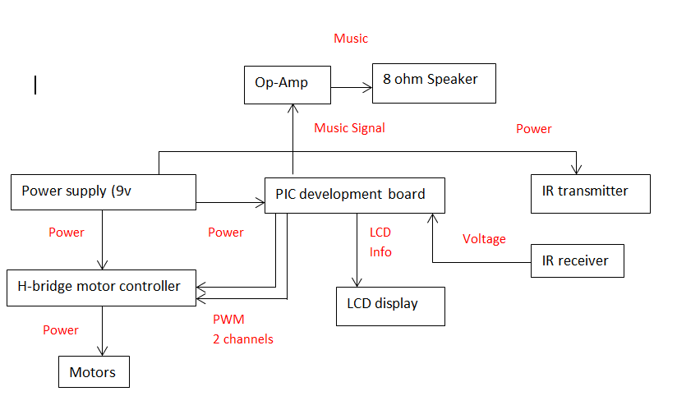
Proposed Design (block diagram)

Slide 9
System Build and Test
Build and Design
Testing
Develop an line following software and hardware
Bar code reading software
Program music and assemble and op-amp and speaker
Adjusting trim to allow for optimal line following
Practice driving over and scanning bar codes
Test music playing while following a line

Slide 10
Task Responsibility
Maryam
Design Lead
Design system functionality
John
Hardware Lead
Design circuit layout
Jacob
Software Lead
Design software architecture
Test and maintain software update
Implement hardware structure
Implement system design

Slide 11
Timeline
Phase One (11/13)
Hardware
Software
Phase Two (11/20)
Hardware
Software
Phase Three (12/4)
Hardware
Build basic robot with infrared sensor for following technique
Design algorithm and coding for line following capability
Insert LCD for Step B qualification
Enhance algorithm for binary input
Software
Develop code for Step A qualification
Insert Step A qualification instruments

Slide 12
Deliverables
PDR and CDR
Demo
Able to follow lines on the ground
Possibility of using similar technology for other applications(i.e. following scents, light, or radiation trails)
Able to read binary input
Useful for relaying information to the robot
Implementation of secondary input mode in future design
Final Report

Slide 13
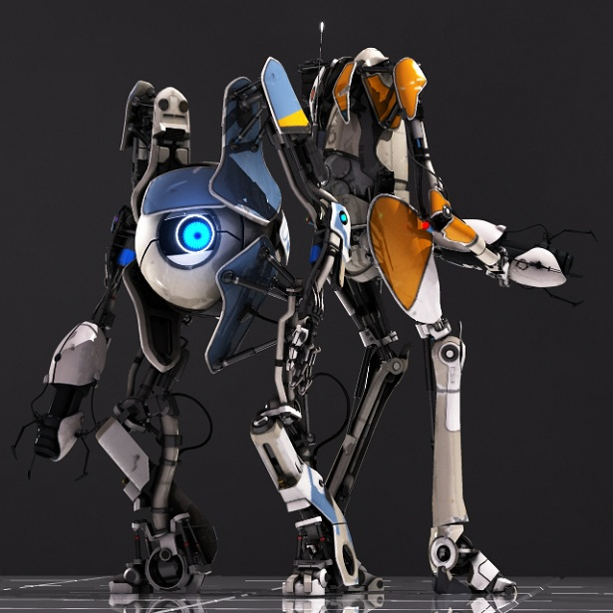
MJ² Robotics
Designing a better future for robokind.
Photo property of Valve Corporation (not our real robots…yet)

